Slide 1

Go Solar
An E-Commerce Website

Slide 2

Problem Statement
Problem 1
Problem 2
Problem 3

Slide 3
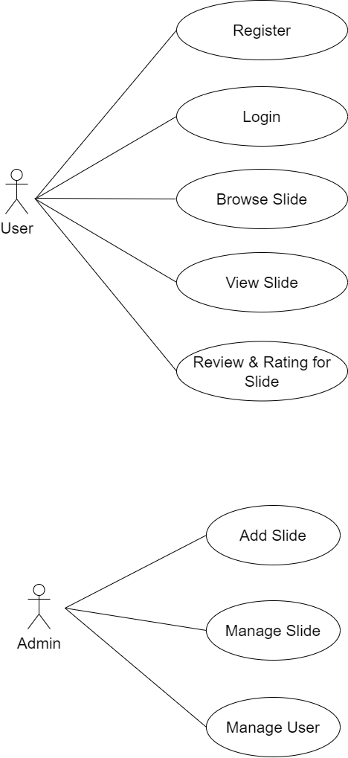

Slide 4
Use Case Diagram

Slide 5
Use Case Diagram
Register

